Slide 1
GST BILLING SOFTWARE
Prepared by
Rishabh Jaishwal
Mohit Kumar
Shivam Kumar
Nipun Kumar

Slide 2
Introduction
GST Billing Software is based on new Indian Tax System for creating Invoice easily with basic knowledge.
It have simple UI in comparison to Tally ERP 9. Tally ERP 9 require training before use because of it’s complex UI.
Our Software Provide different Panel access for employee and admin.
Statistics can be easily taken by admin for the Invoices created by different Employee.
By using Java Print API , We can also Print the Invoice for Customer.

Slide 3
Software Used
Java JDK version 1.7 or above
MySql database
Jtatoo Jar for UI Design
Java Mysql Database Connector Jar

Slide 4
Hardware Used For Development/Testing
I3 processor (1.7 GHZ 4th generation)
4 GB RAM
500 GB Hard Disk

Slide 5
UI Design
Jtatoo library for UI Design Look and Feel
Package used For UI Design “com.jtattoo.plaf.mcwin.McWinLookAndFeel”
Layout MDI Application

Slide 6
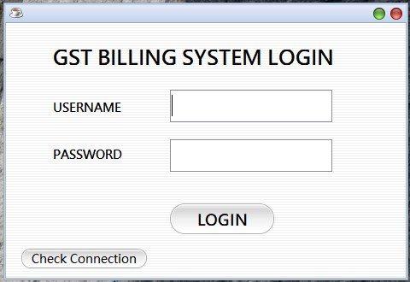
Demo Pages for GST Billing Software
Single Login Field for Logged Into Software As Employee Or Admin.
Use of Two Roles Give Different Permission To access the Software.
Used for Login into Software
Used for Database Configuration Manually

Slide 7
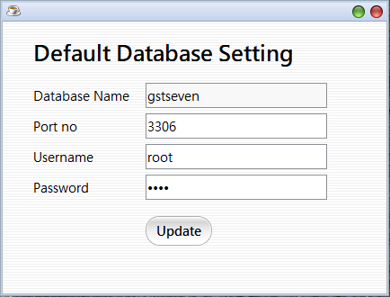
Check Connection
Configure Database Setting Manually
View Database Setting
And the update button just not only save the default database Setting it also create the database and tables (if not created).
The Default Database Setting stores into a files located in the location where jar is located.

Slide 8
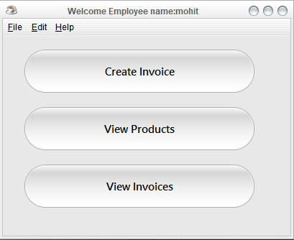
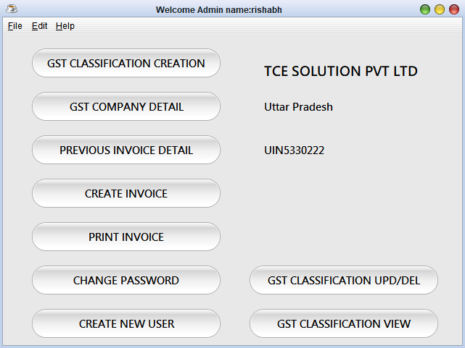
After Login MDI Application Starts
Employee Panel
Admin Panel

Slide 9
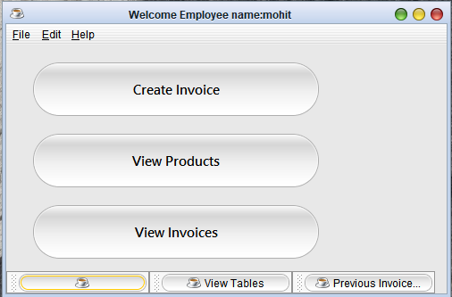
Access Multiple Pages
We can access multiple pages at the mid of any work on specific page without loosing data.
Minimized Pages

Slide 10
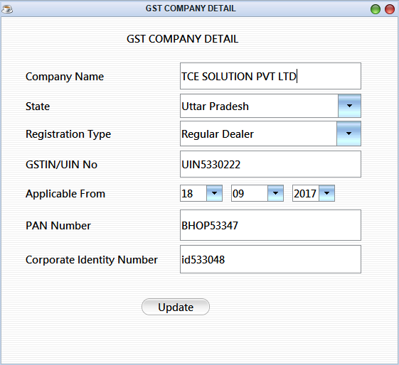
JInternal Frame for Changing Company Details

Slide 11
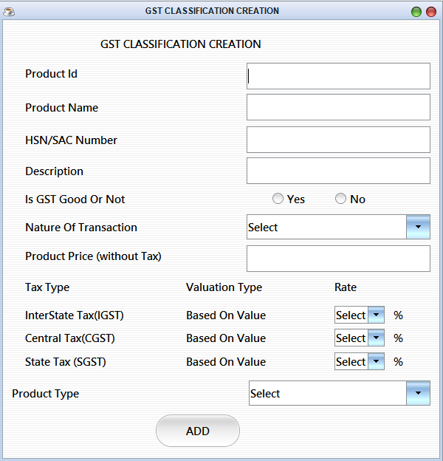
JInternal Frame for Creating GST Products

Slide 12
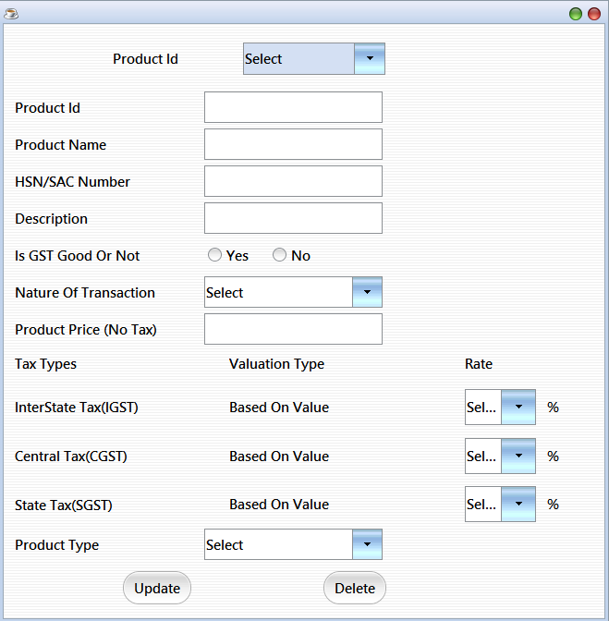
Update/Delete GST Product Classification

Slide 13
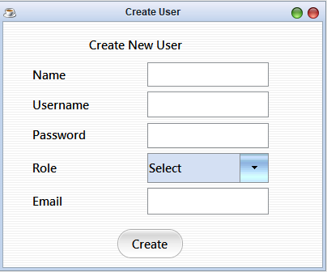
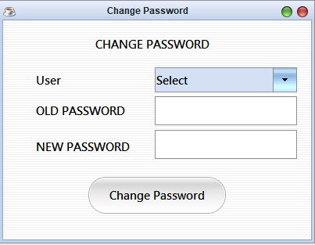
Creating New Login/Changing Password from Admin Panel

Slide 14
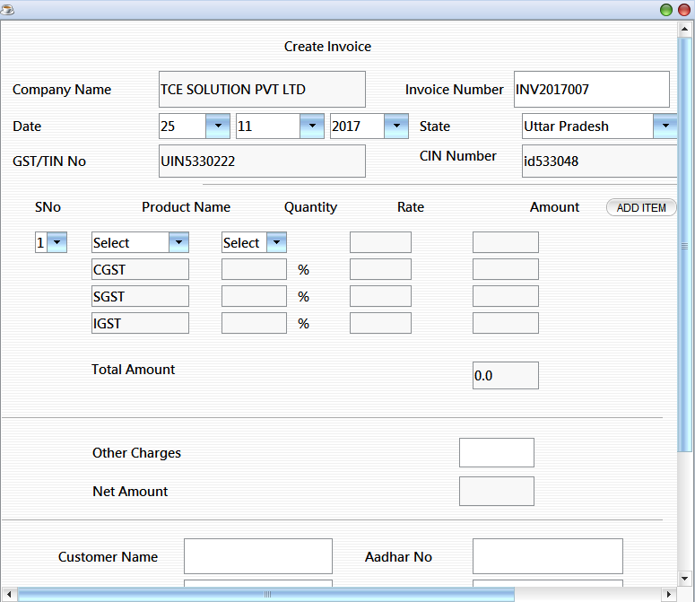
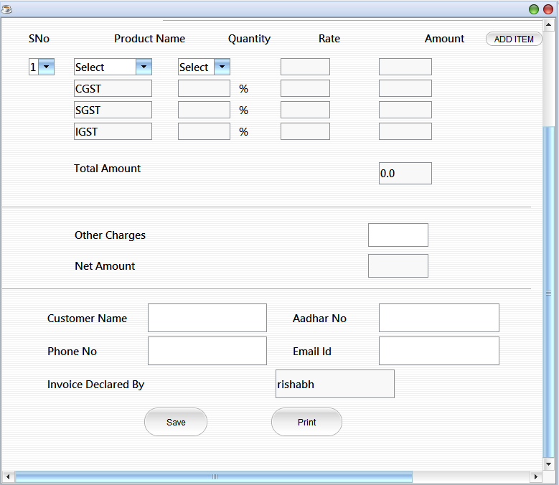
Create And Print Invoice

Slide 15
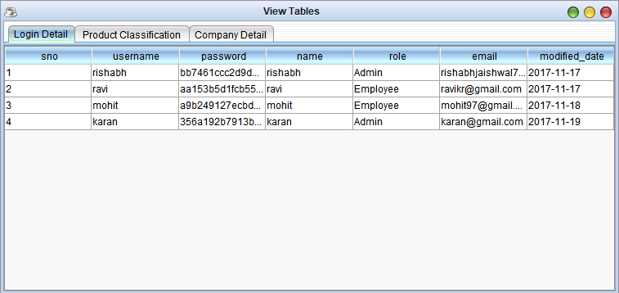
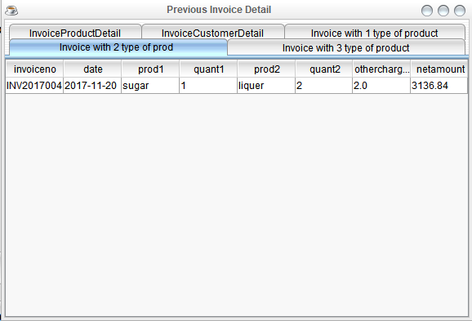
Tables for Statistics

Slide 16
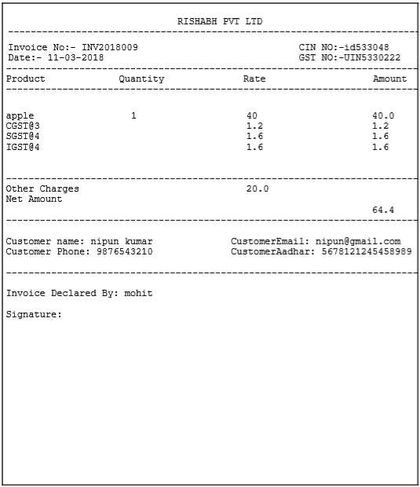
Printed Invoice

Slide 17
Thank You

